Slide 1
Distributed Systems
Naming
Chapter 5

Slide 2
Course/Slides Credits
Note: all course presentations are based on those developed by Andrew S. Tanenbaum and Maarten van Steen. They accompany their "Distributed Systems: Principles and Paradigms" textbook (1st & 2nd editions).
http://www.prenhall.com/divisions/esm/app/author_tanenbaum/custom/dist_sys_1e/index.html
And additions made by Paul Barry in course CW046-4: Distributed Systems
http://glasnost.itcarlow.ie/~barryp/net4.html

Slide 3
Naming
Naming systems play an important role in all computer systems, and especially within a distributed environment.
The three main areas of study:
  The organization and implementation of human-friendly naming systems.
  Naming as it relates to mobile entities.
  Garbage collection – what to do when a name is no longer needed.

Slide 4
Some Definitions
Entity – just about any resource.
Name – a string (often human-friendly) that refers to an entity.
Address – an entities “access-point”.
A name for an entity that is independent of an address is referred to as “location independent”.
Identifier – a reference to an entity that is often unique and never reused.

Slide 5
Names, Identifiers, and Addresses
Properties of a true identifier:
  An identifier refers to at most one entity.
  Each entity is referred to by at most one identifier.
  An identifier always refers to the same entity.

Slide 6
Locating Mobile Entities
Tricky …
Traditional naming services (DNS, X.500) are not suited to environments where entities change location (i.e., move).
The assumption is that moves occur rarely at the Global and Administrative layers, and when moves occur at the Managerial layer, the entity stays within the same domain.
But, what happens if ftp.cs.vu.nl moves to ftp.cs.unisa.edu.au?

Slide 7
Possible Solutions
A record of the new address of the entity is stored in the cs.vu.nl name server.
A record of the name of the new entity is stored in the cs.vu.nl name server (i.e., a symbolic link is created).
Both “solutions” seem OK, until you consider what happens when the entity moves again, then again, then again …
Consequently, both “solutions” can be shown to be inefficient and unscalable.

Slide 8
More Location Problems
Even non-mobile entities that change their name often cause name space problems – consider the DNS within a DHCP
environment (currently incompatible).
So … a different solution is needed.
What’s required is a “Location Service”
(or middle-man technology).

Slide 9
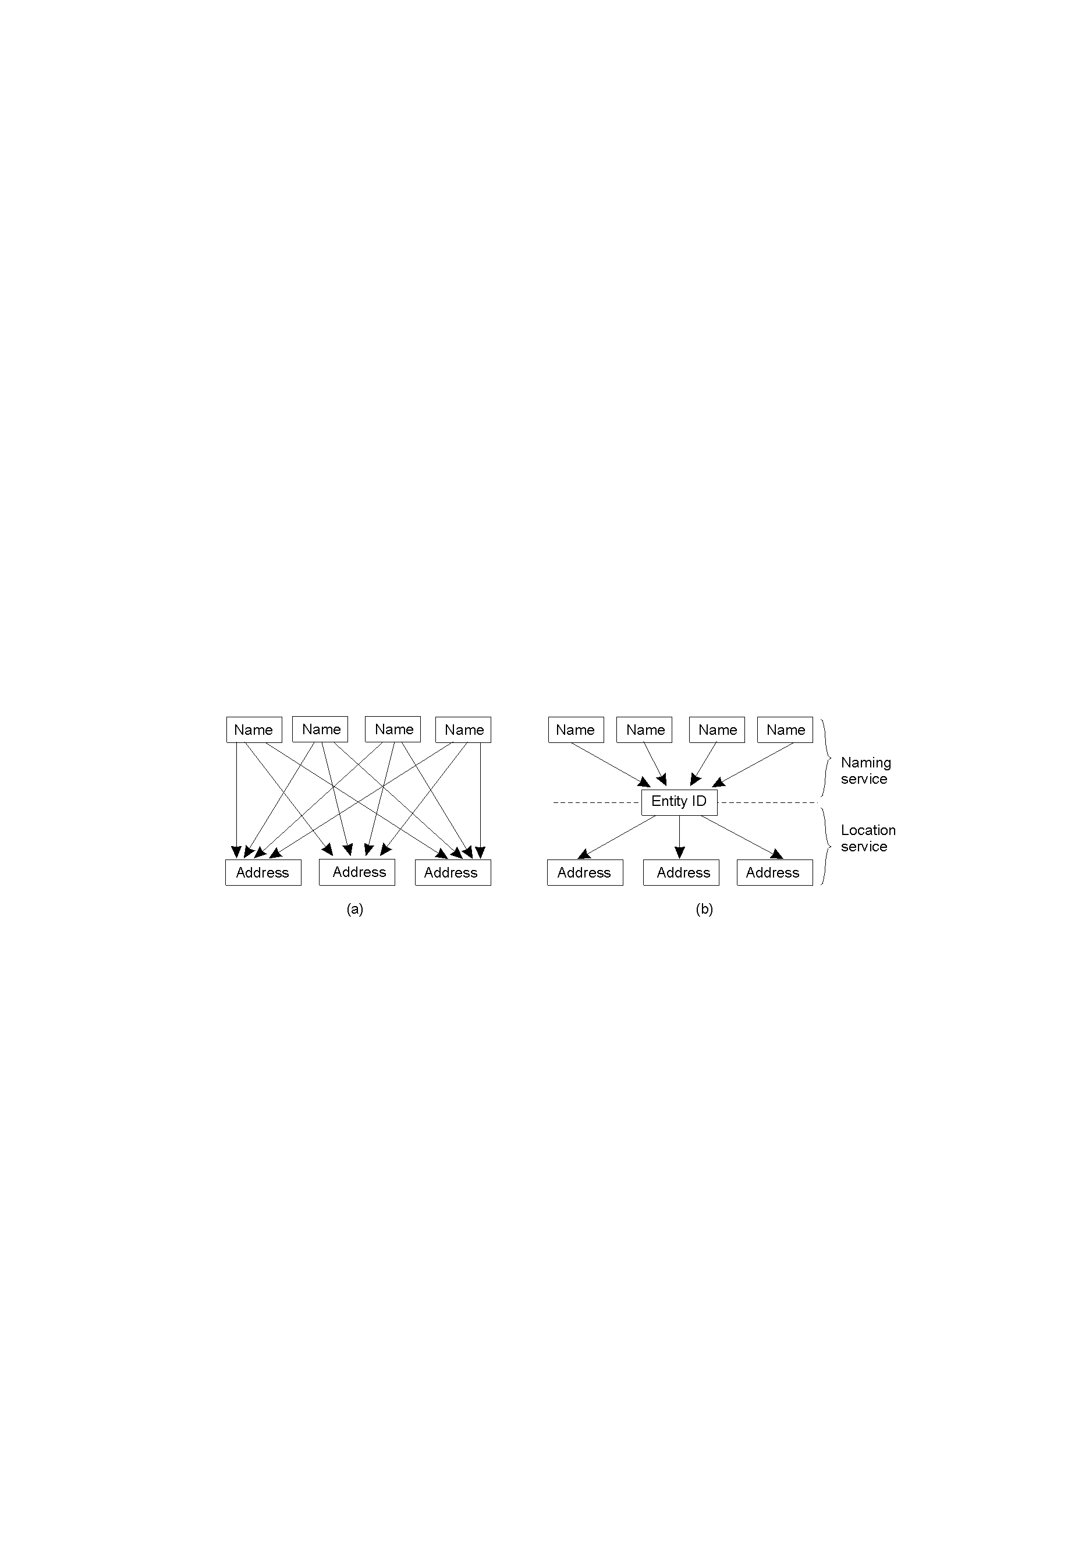
Naming vs. Location Services
Direct, single-level mapping between names and addresses.
Two-level mapping using a “location service”.

Slide 10
Simple Solutions Broadcasting
Broadcasting and Multicasting technologies.
Sending out “where are you?” packets …
Classic example: Address Resolution Protocol (ARP) as used by the TCP/IP suite for resolving IP names to underlying networking technology addresses.
Works well (on LAN’s and other broadcast technologies), but doesn’t scale well.

Slide 11
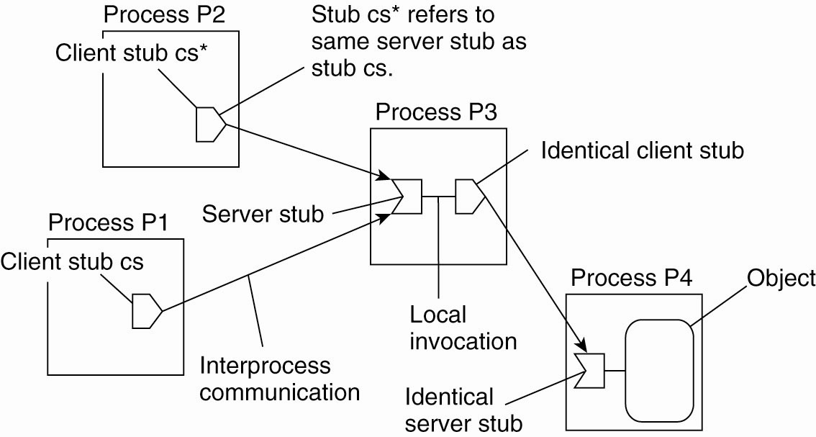
Forwarding Pointers (1)
The principle of forwarding pointers
using (client stub, server stub) pairs

Slide 12
Disadvantages of Forwarding Pointers
A chain can become very long, and the “lookup” eventually becomes prohibitively expensive.
All the “intermediate locations” must maintain their chains for “as long as needed” (however long that is).
Big vulnerability: broken links. Break a link and a forwarded entity is lost …

Slide 13
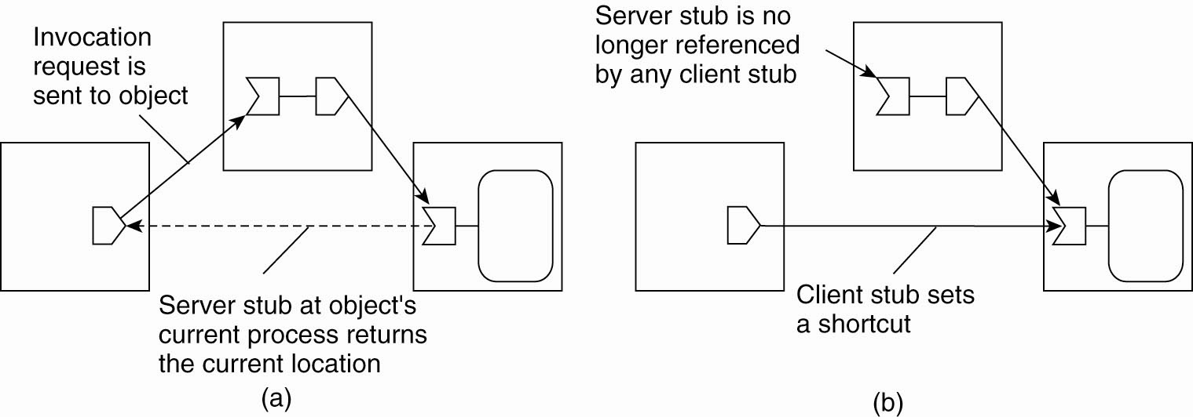
Forwarding Pointers (2)
(a) Redirecting a forwarding pointer by
storing a shortcut in a client stub

Slide 14
Forwarding Pointers (3)
(b) Redirecting a forwarding pointer by
storing a shortcut in a client stub

Slide 15
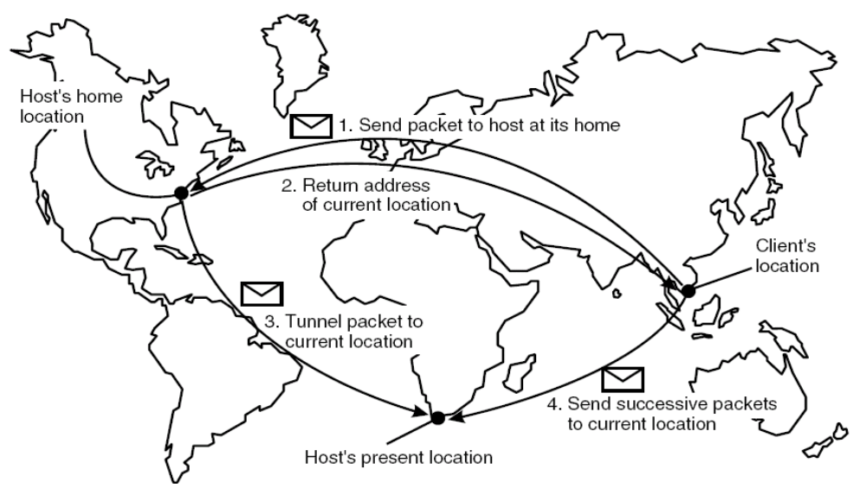
Home-Based Approaches
The principle of Mobile IP

Slide 16
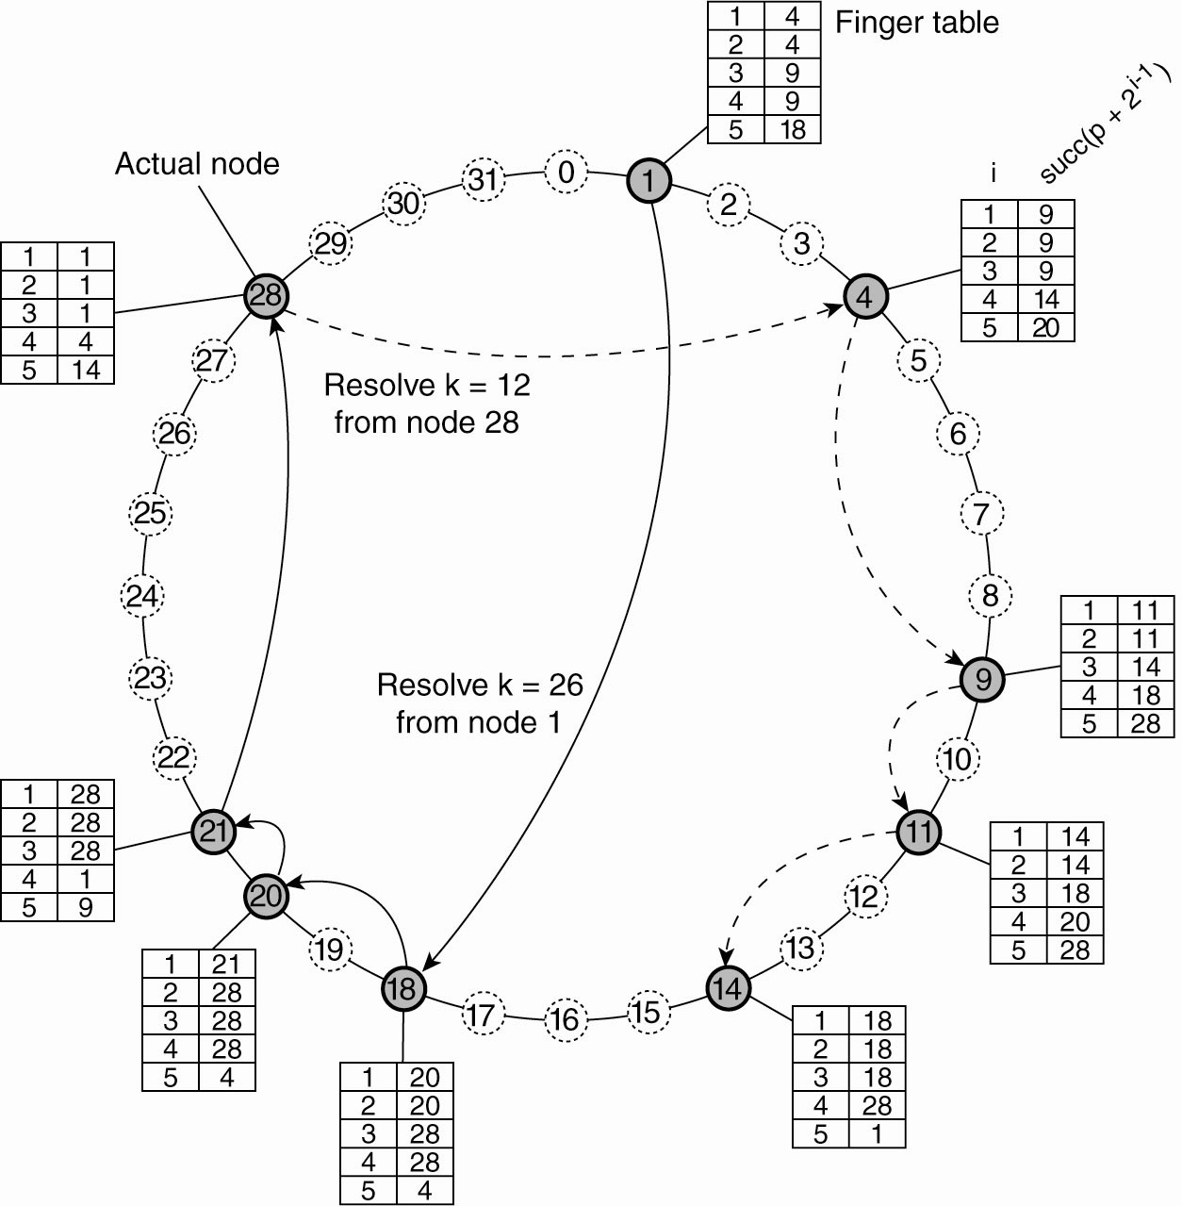
Distributed Hash Tables
General Mechanism
Resolving key 26 from node 1 and
key 12 from node 28 in a Chord system

Slide 17
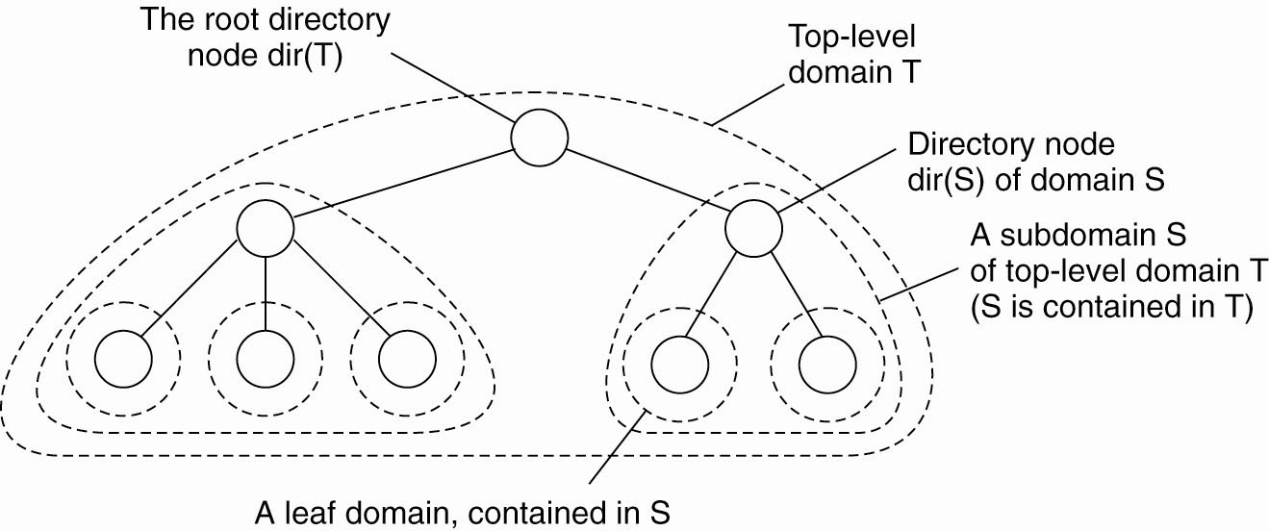
Hierarchical Approaches (1)
Hierarchical organization of a location service into
domains, each having an associated directory node

Slide 18
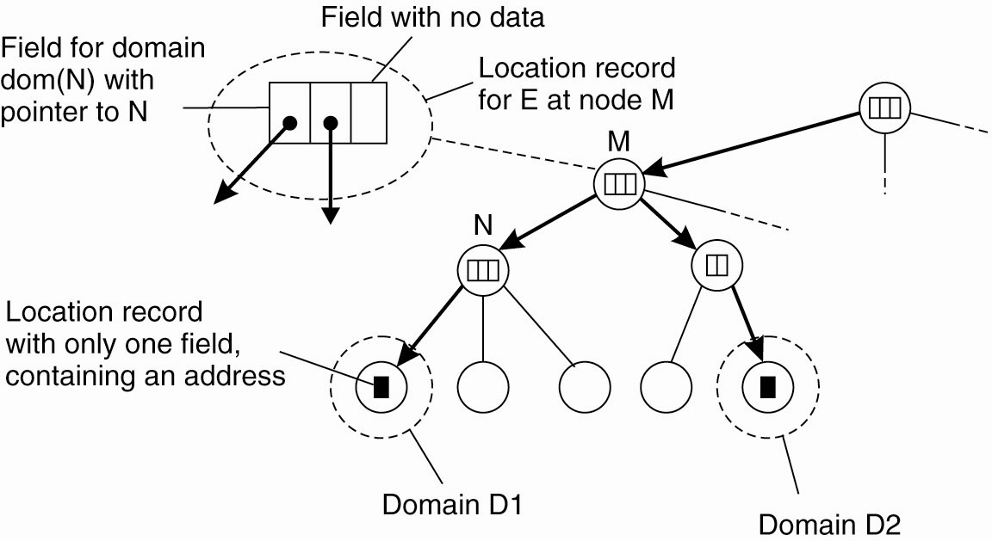
Hierarchical Approaches (2)
An example of storing information of an entity
having two addresses in different leaf domains

Slide 19
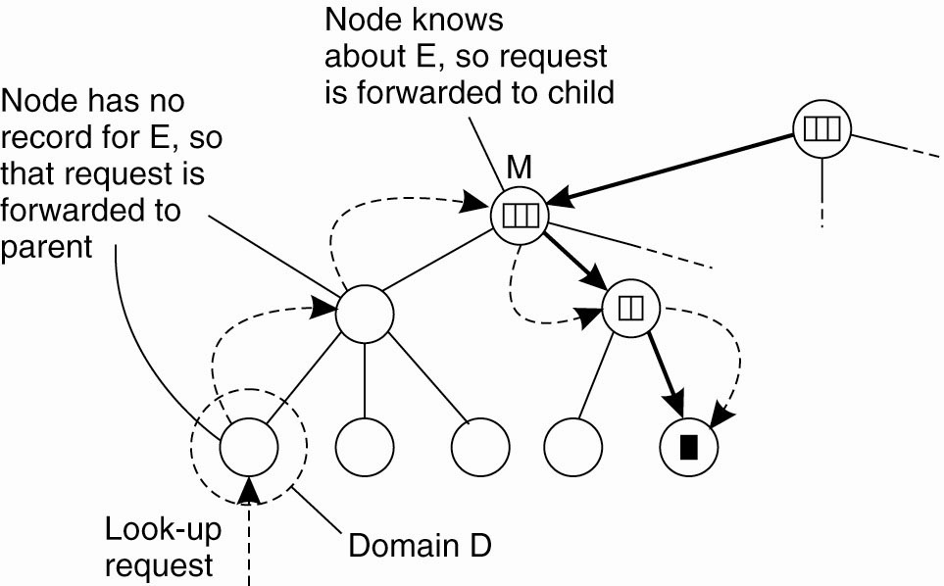
Hierarchical Approaches (3)
Looking up a location in a hierarchically
organized location service

Slide 20
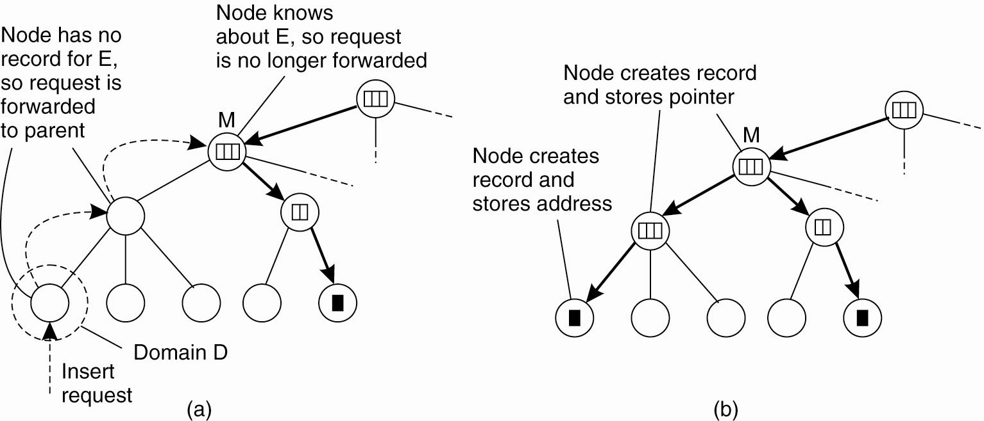
Hierarchical Approaches (4)
(a) An insert request is forwarded to the
first node that knows about entity E

Slide 21
Hierarchical Approaches (5)
(b) A chain of forwarding pointers
to the leaf node is created

Slide 22
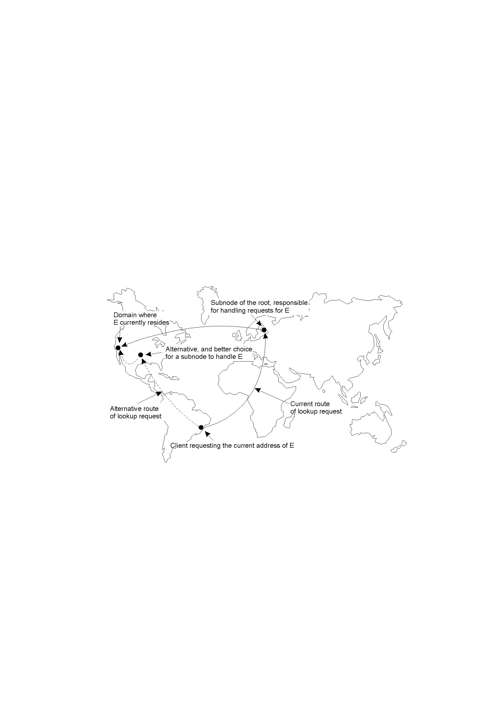
Scalability Issues with the Hierarchy
The scalability issues related to uniformly placing subnodes of a partitioned root node across the network covered by a location service

Slide 23
Structured Naming - Name Spaces (1)
Names are often organized into name spaces.
Within distributed systems, a name space is represented by a labeled, directed graph with two types of nodes:
  leaf nodes: information on an entity.
  directory nodes: a collection of named outgoing edges (which can lead to any other type of node).
Each name space has at least one root node.
Nodes can be referred to by path names (with
absolute or relative).
File systems are a classic example …

Slide 24
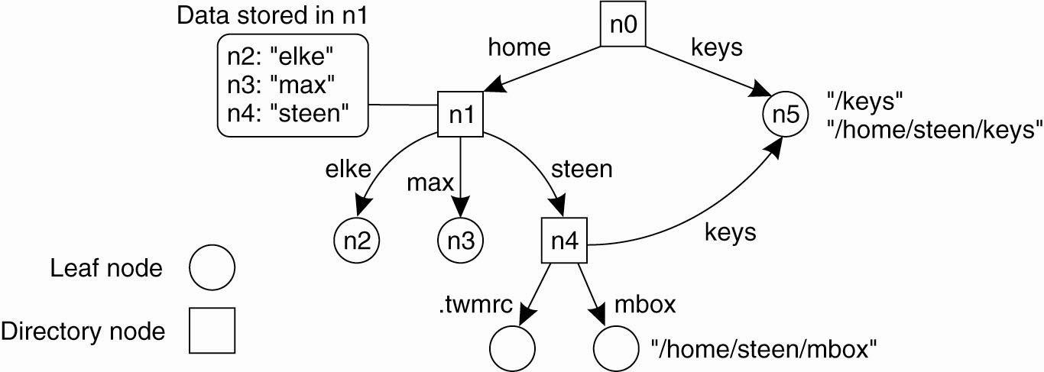
Name Spaces (2)
A general naming graph with a single root node

Slide 25
Other Name Space Examples
UNIX file system implementation (with NFS enhancements to support “remote mounting” of remote file systems).
SNMP MIB-II (a “sub-namespace”
within a much larger name space maintained by the ISO).
DNS (more on this later).

Slide 26
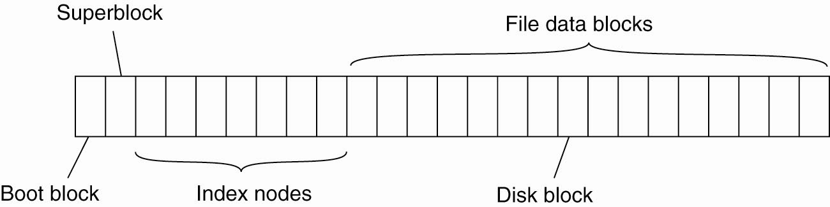
Unix Name Space
The general organization of the UNIX file
system implementation on a logical disk
of contiguous disk blocks

Slide 27
Introducing Name Resolution
The process of looking up information stored
in the node given just the path name.
And assuming, of course, that you know where to start …
This can be complicated by techniques that have been devised to combine namespaces (such as Sun’s NFS mounting and DEC’s GNS) …

Slide 28
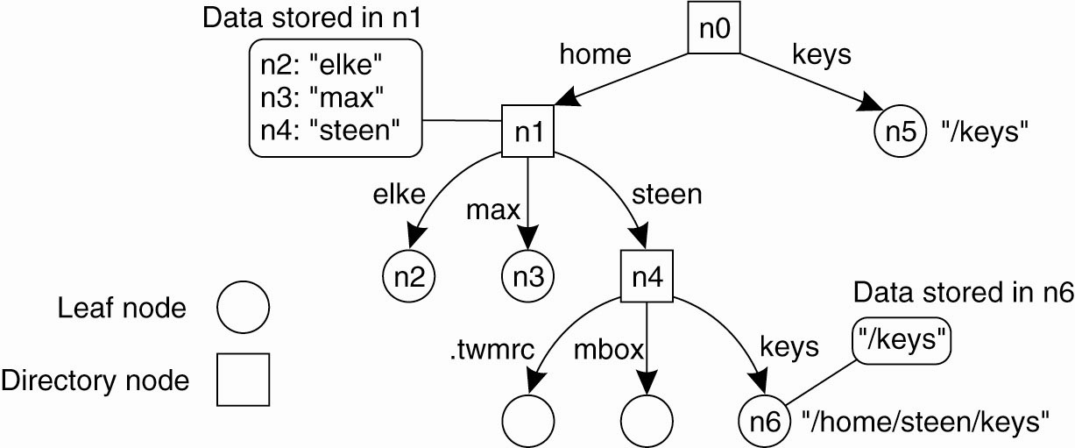
Linking and Mounting (1)
The concept of a symbolic link
explained in a naming graph

Slide 29
Linking and Mounting (2)
Information required to mount a foreign name space in a distributed system.
The name of an access protocol.
The name of the server.
The name of the mounting point in the foreign name space.

Slide 30
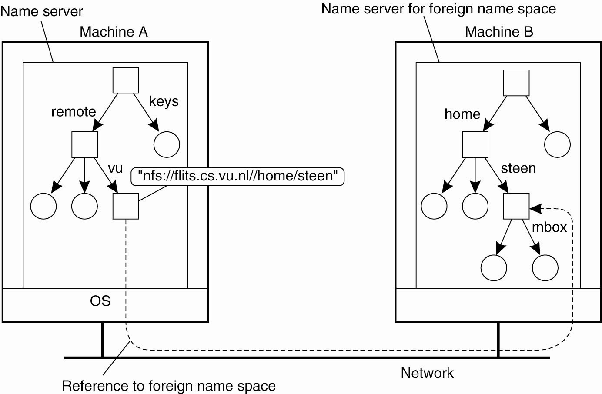
Linking and Mounting (3)
Mounting remote name spaces
through a specific access protocol

Slide 31
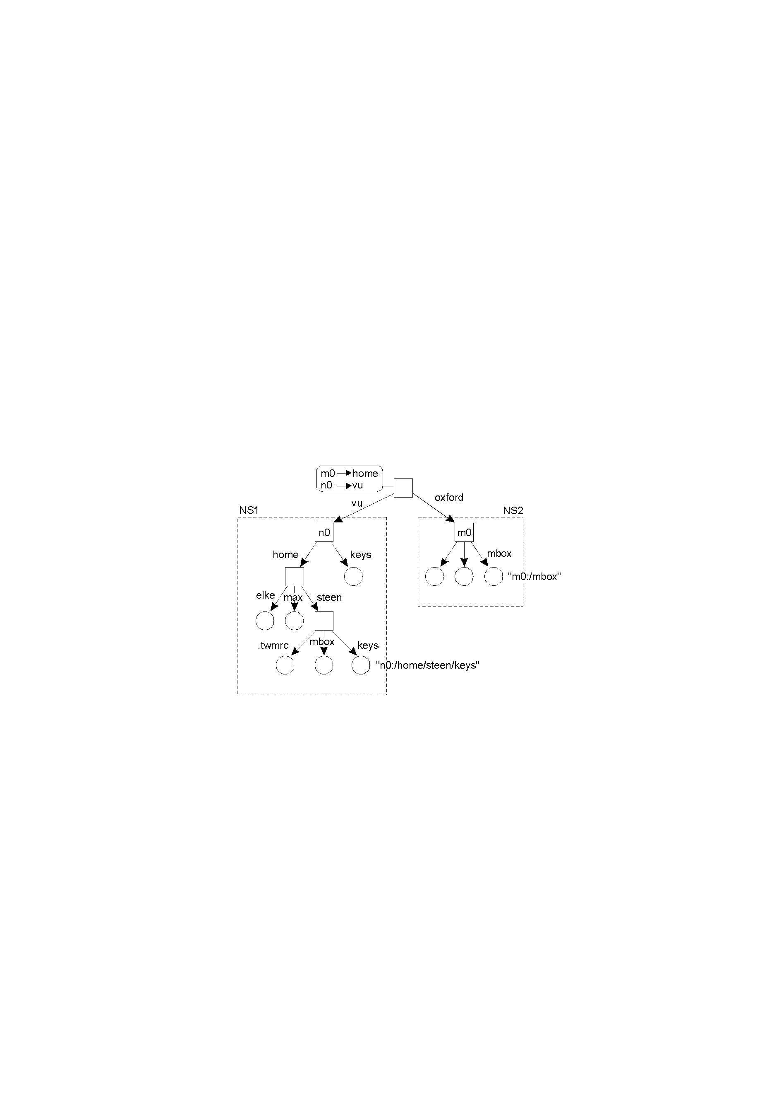
Linking and Mounting (4)
Organization of the DEC “Global Name Service” (adds a new root node and makes existing root nodes its children).

Slide 32
Implementing Name Spaces
A Name Service allows users and processes to add, remove and lookup names.
Name services are implemented by Name Servers.
On LAN’s – a single server usually suffices (think of a ‘local’ DNS).
On WAN’s – a distributed solution is often more practical (think of the ‘global’ DNS).
Often, name spaces (and services) are organized into one of three layers.

Slide 33
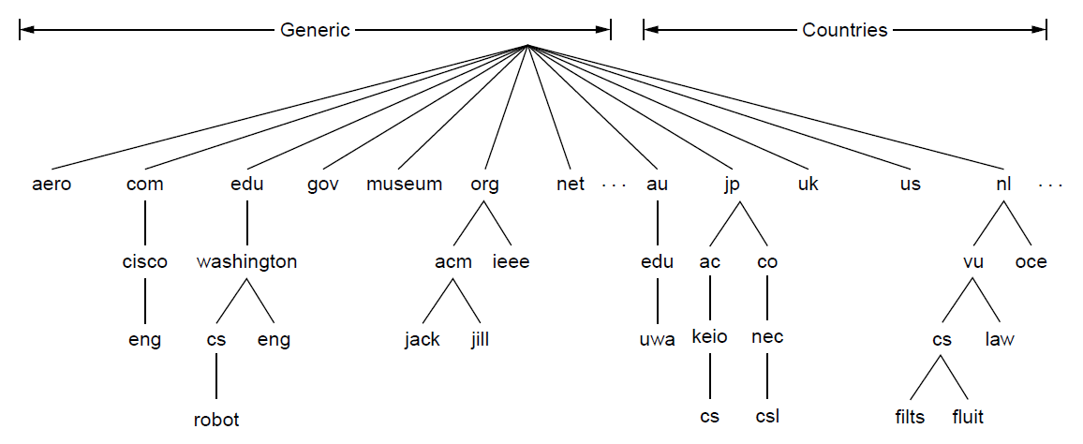
A potion of the DNS Name Space

Slide 34
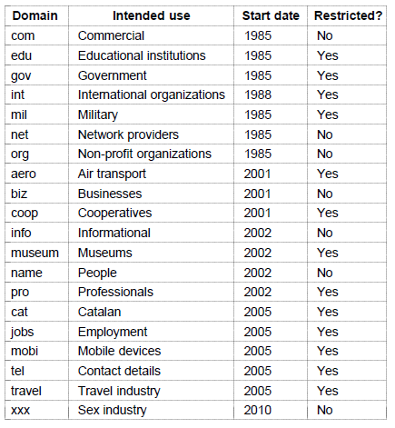
Generic Top-level Domains

Slide 35
The Three Name Space Layers
Global Layer: highest level nodes (root);
stable; entries change very infrequently.
Administrational Layer: directory nodes managed by a single organization; relatively stable; although changes can occur more frequently.
Managerial Layer: nodes change frequently; nodes maintained by users as well as administrators; nodes are the ‘leaf entities’,
and can often change.

Slide 36
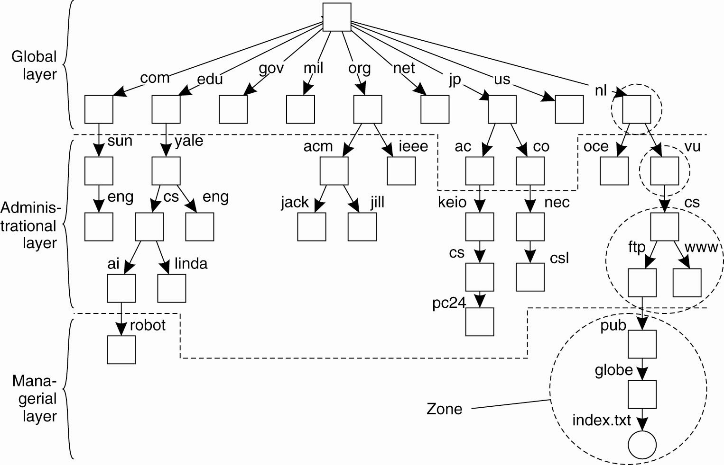
Name Space Distribution (1)
An example partitioning of the DNS name space, including Internet-accessible files, into three layers

Slide 37
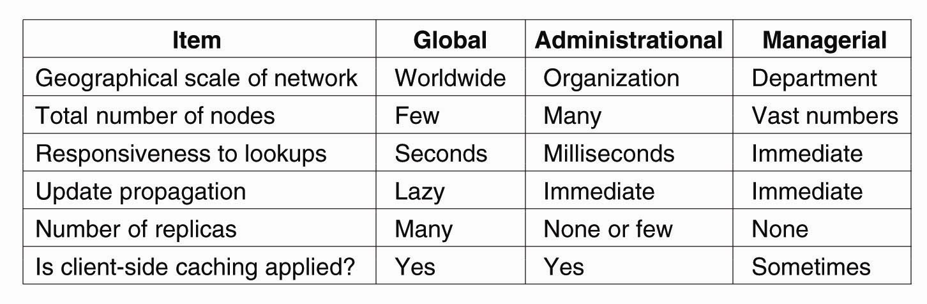
Name Space Distribution (2)
A comparison between name servers for implementing nodes from a large-scale name space partitioned into a global layer, an administrational layer, and a managerial layer

Slide 38
More on Name Resolution
A “name resolver” provides a local name resolution service to clients –
it is responsible for ensuring that the name resolution process is carried out.
Two Common Approaches:
  1. Iterative Name Resolution.
  2. Recursive Name Resolution.

Slide 39
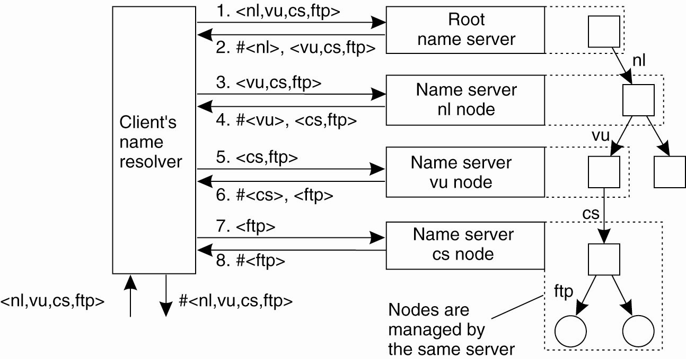
Implementation of Name Resolution (1)
The principle of iterative name resolution

Slide 40
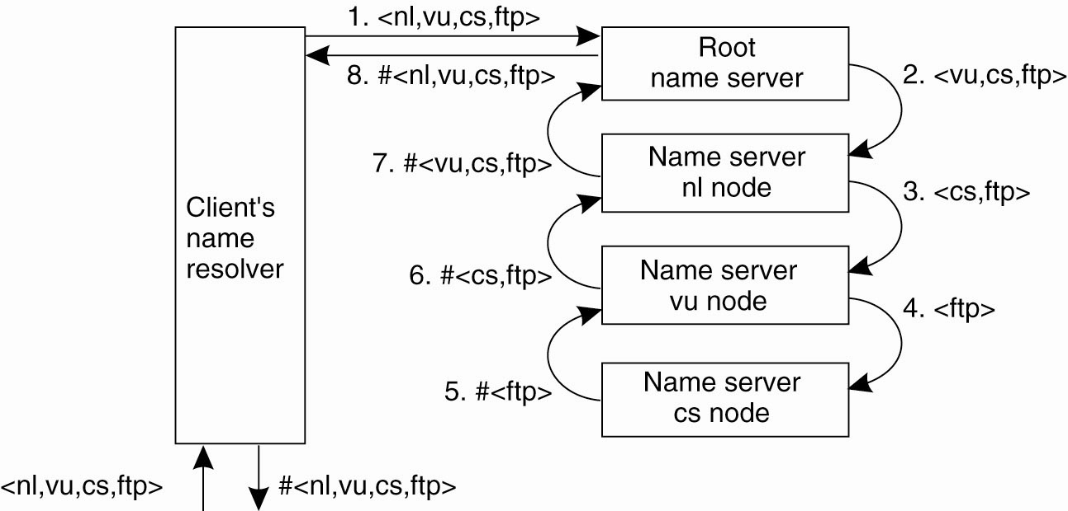
Implementation of Name Resolution (2)
The principle of recursive name resolution

Slide 41
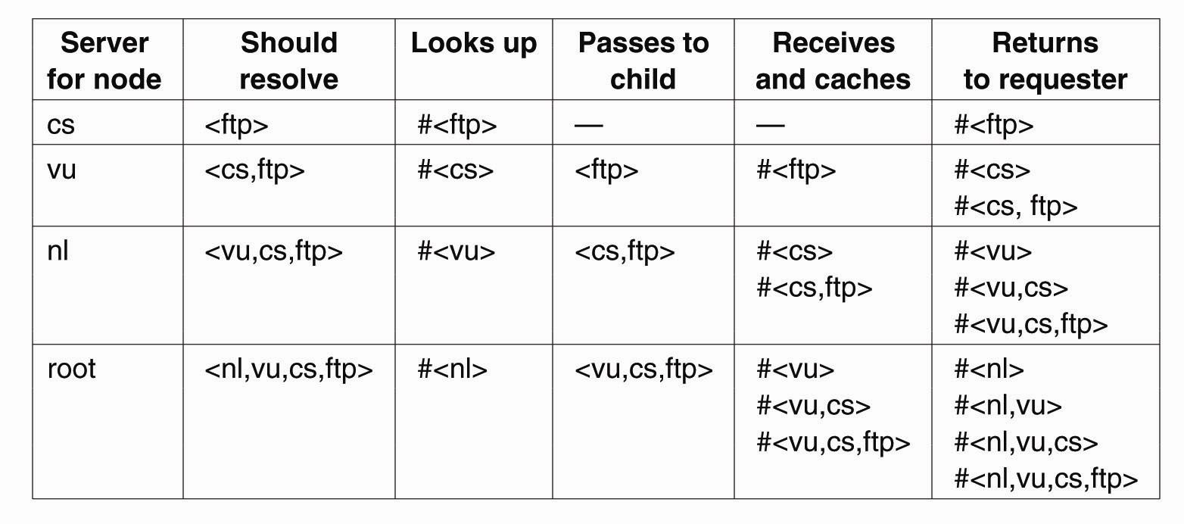
Implementation of Name Resolution (3)
Recursive name resolution of <nl, vu, cs, ftp>. Name servers cache intermediate results for subsequent lookups.

Slide 42
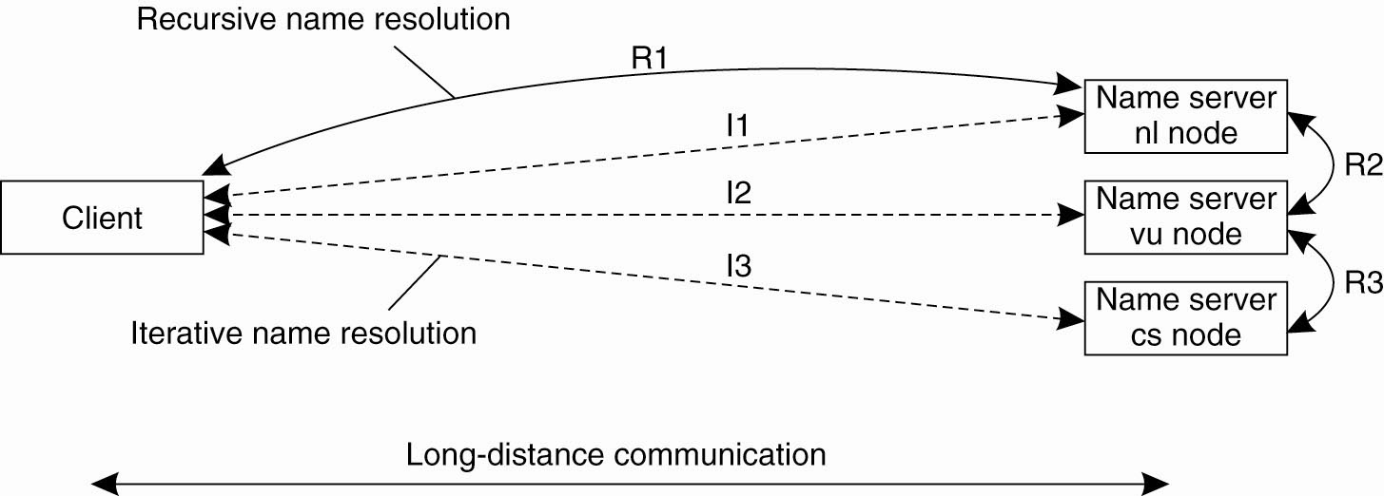
Geographical Scalability
The comparison between recursive and iterative name resolution with respect to communication costs

Slide 43
Structured Naming - Example: DNS
“One of the largest distributed naming services in use today.”
DNS is a classic “rooted tree” naming system.
Each label (the bit between the ‘.’) must be < 64 chars.
Each path (the whole thing) must be < 256 chars.
The root is given the name ‘.’ (although, in practice, the dot is rarely shown nor required).

Slide 44
DNS Names
A subtree within DNS is referred to as a “domain”.
A path name is referred to as a “domain name”.
These can be relative or absolute.
DNS server operates at each node (except those at the bottom). Here, the information is organized into “resource records”.

Slide 45
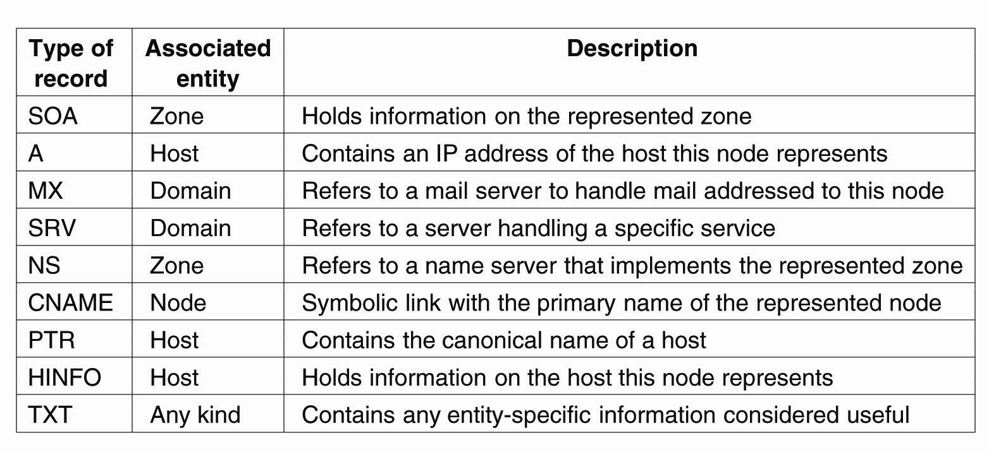
DNS Resource Record Types (1)
The most important types of resource records forming the contents of nodes in the DNS name space

Slide 46
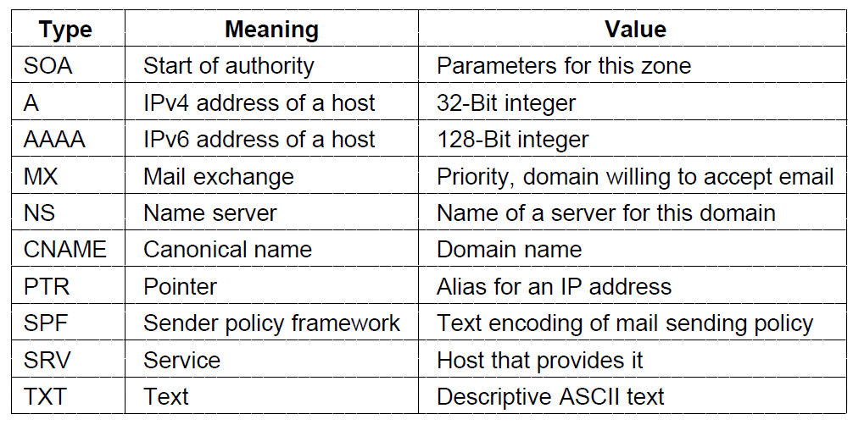
DNS Resource Record Types (2)

Slide 47
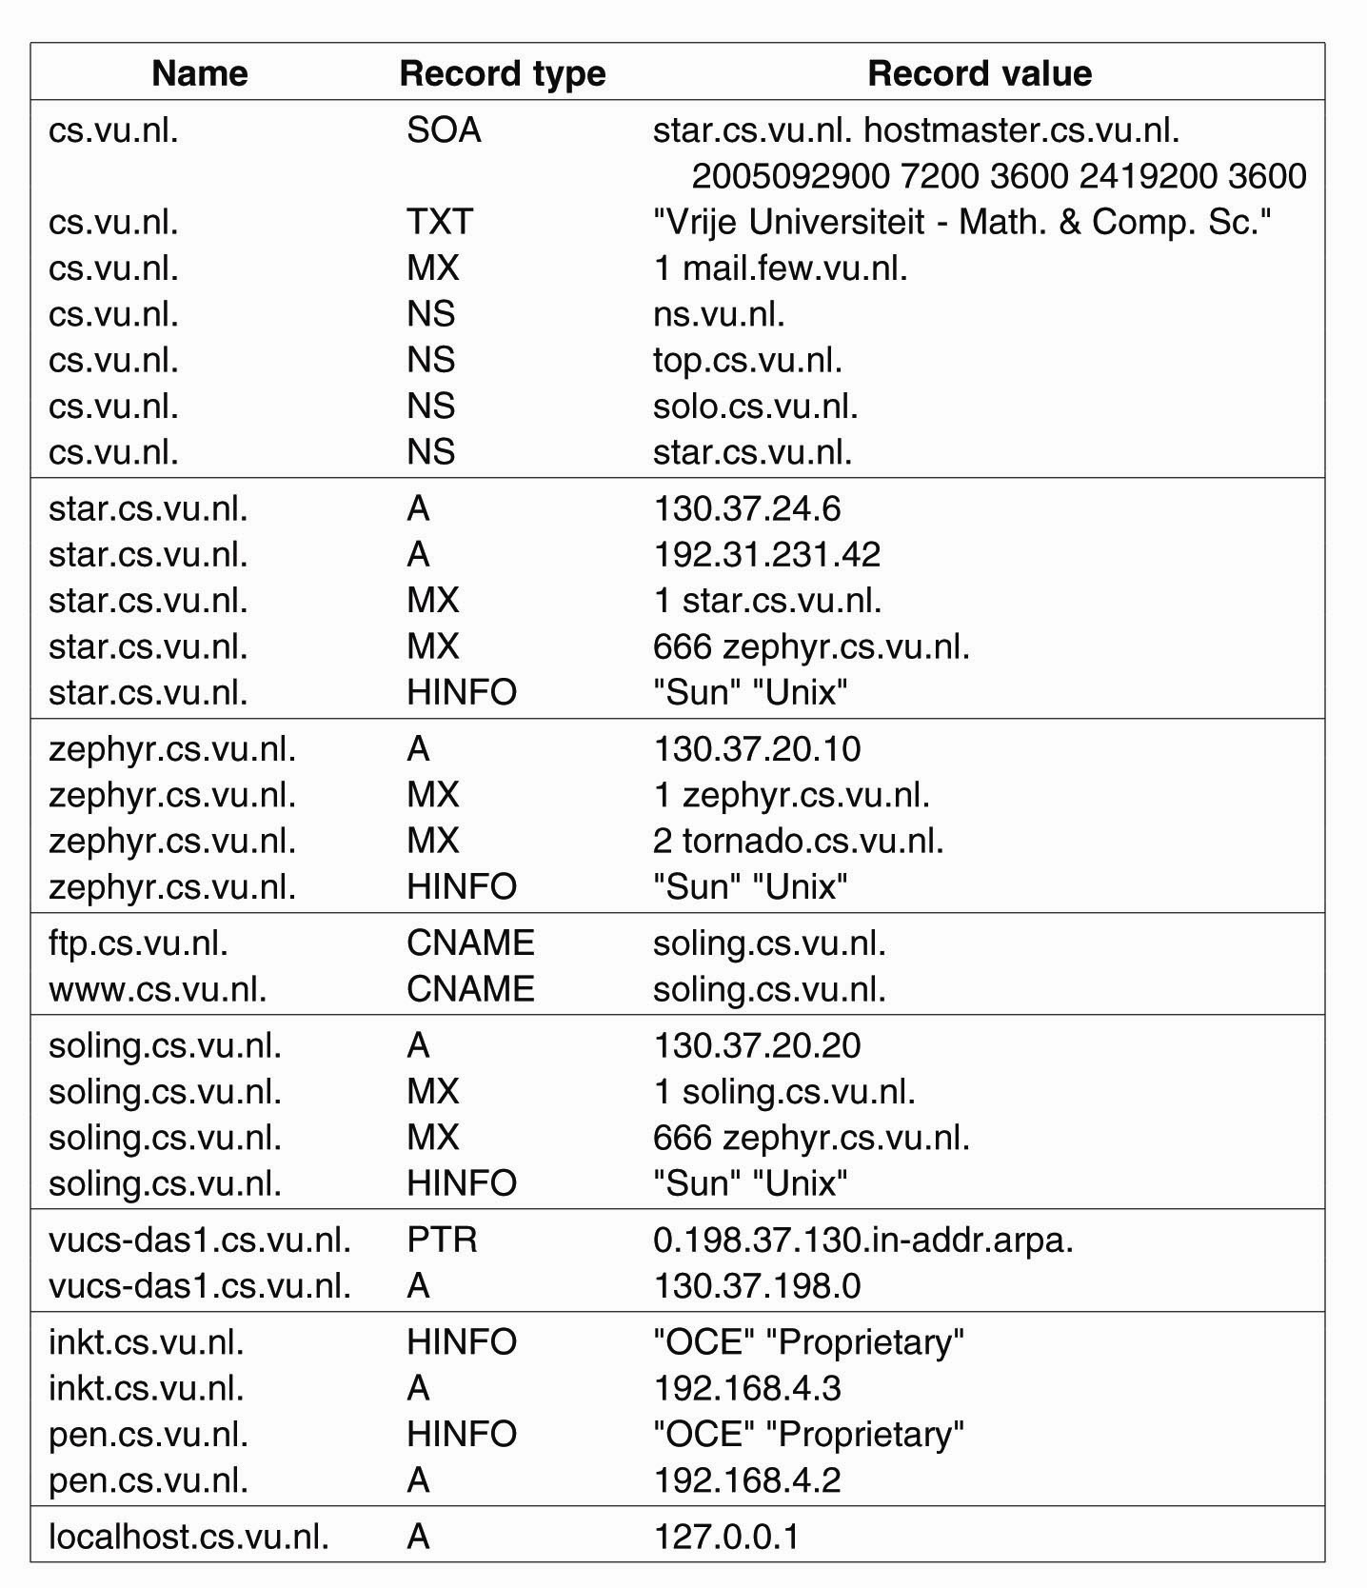
DNS Implementation (1)
An excerpt from the DNS for the zone cs.vu.nl

Slide 48
DNS Implementation (2)
An excerpt from the DNS
database for the zone cs.vu.nl.

Slide 49
Unstructured Naming
Example: X.500 Naming Service
A traditional naming service (like DNS) operates much like the Telephone Directory.
  Find ‘B’, then find ‘Barry’, then find ‘Paul’, then get the number.
With a directory service, the client can look for an entity based on a description of its properties instead of its full name. This is more like the Yellow Pages.
  Find ‘Perl Consultants’, obtain the list, search the list, find ‘Paul Barry’, then get the number.

Slide 50
More on X.500
Directory entries in X.500 are roughly equivalent to domain names in DNS.
The entries are organized as a series of “Attribute/Value Pairings”
A collection of directory entries is referred to as a Directory Information Base (DIB).

Slide 51
X.500 Attribute/Value Pairings
Attribute | Abbr. | Value
Country | C | NL
Locality | L | Amsterdam
Organization | L | Vrije Universiteit
OrganizationalUnit | OU | Math. & Comp. Sc.
CommonName | CN | Main server
Mail_Servers | -- | 130.37.24.6, 192.31.231,192.31.231.66
FTP_Server | -- | 130.37.21.11
WWW_Server | -- | 130.37.21.11
A simple example of a X.500 directory entry using X.500 naming conventions. (Note: both Microsoft and Novell have based their name space technology on the X.500 standard).

Slide 52
X.500 RDN’s and DIT’s
A collection of naming attributes is called a Relative Distinguished Name (RDN).
RDN’s can be arranged in sequence into a Directory Information Tree (DIT).
The DIT is usually partitioned and distributed across several servers (called Directory Service Agents – DSA).
Clients are known as Directory User Agents – DUA.

Slide 53
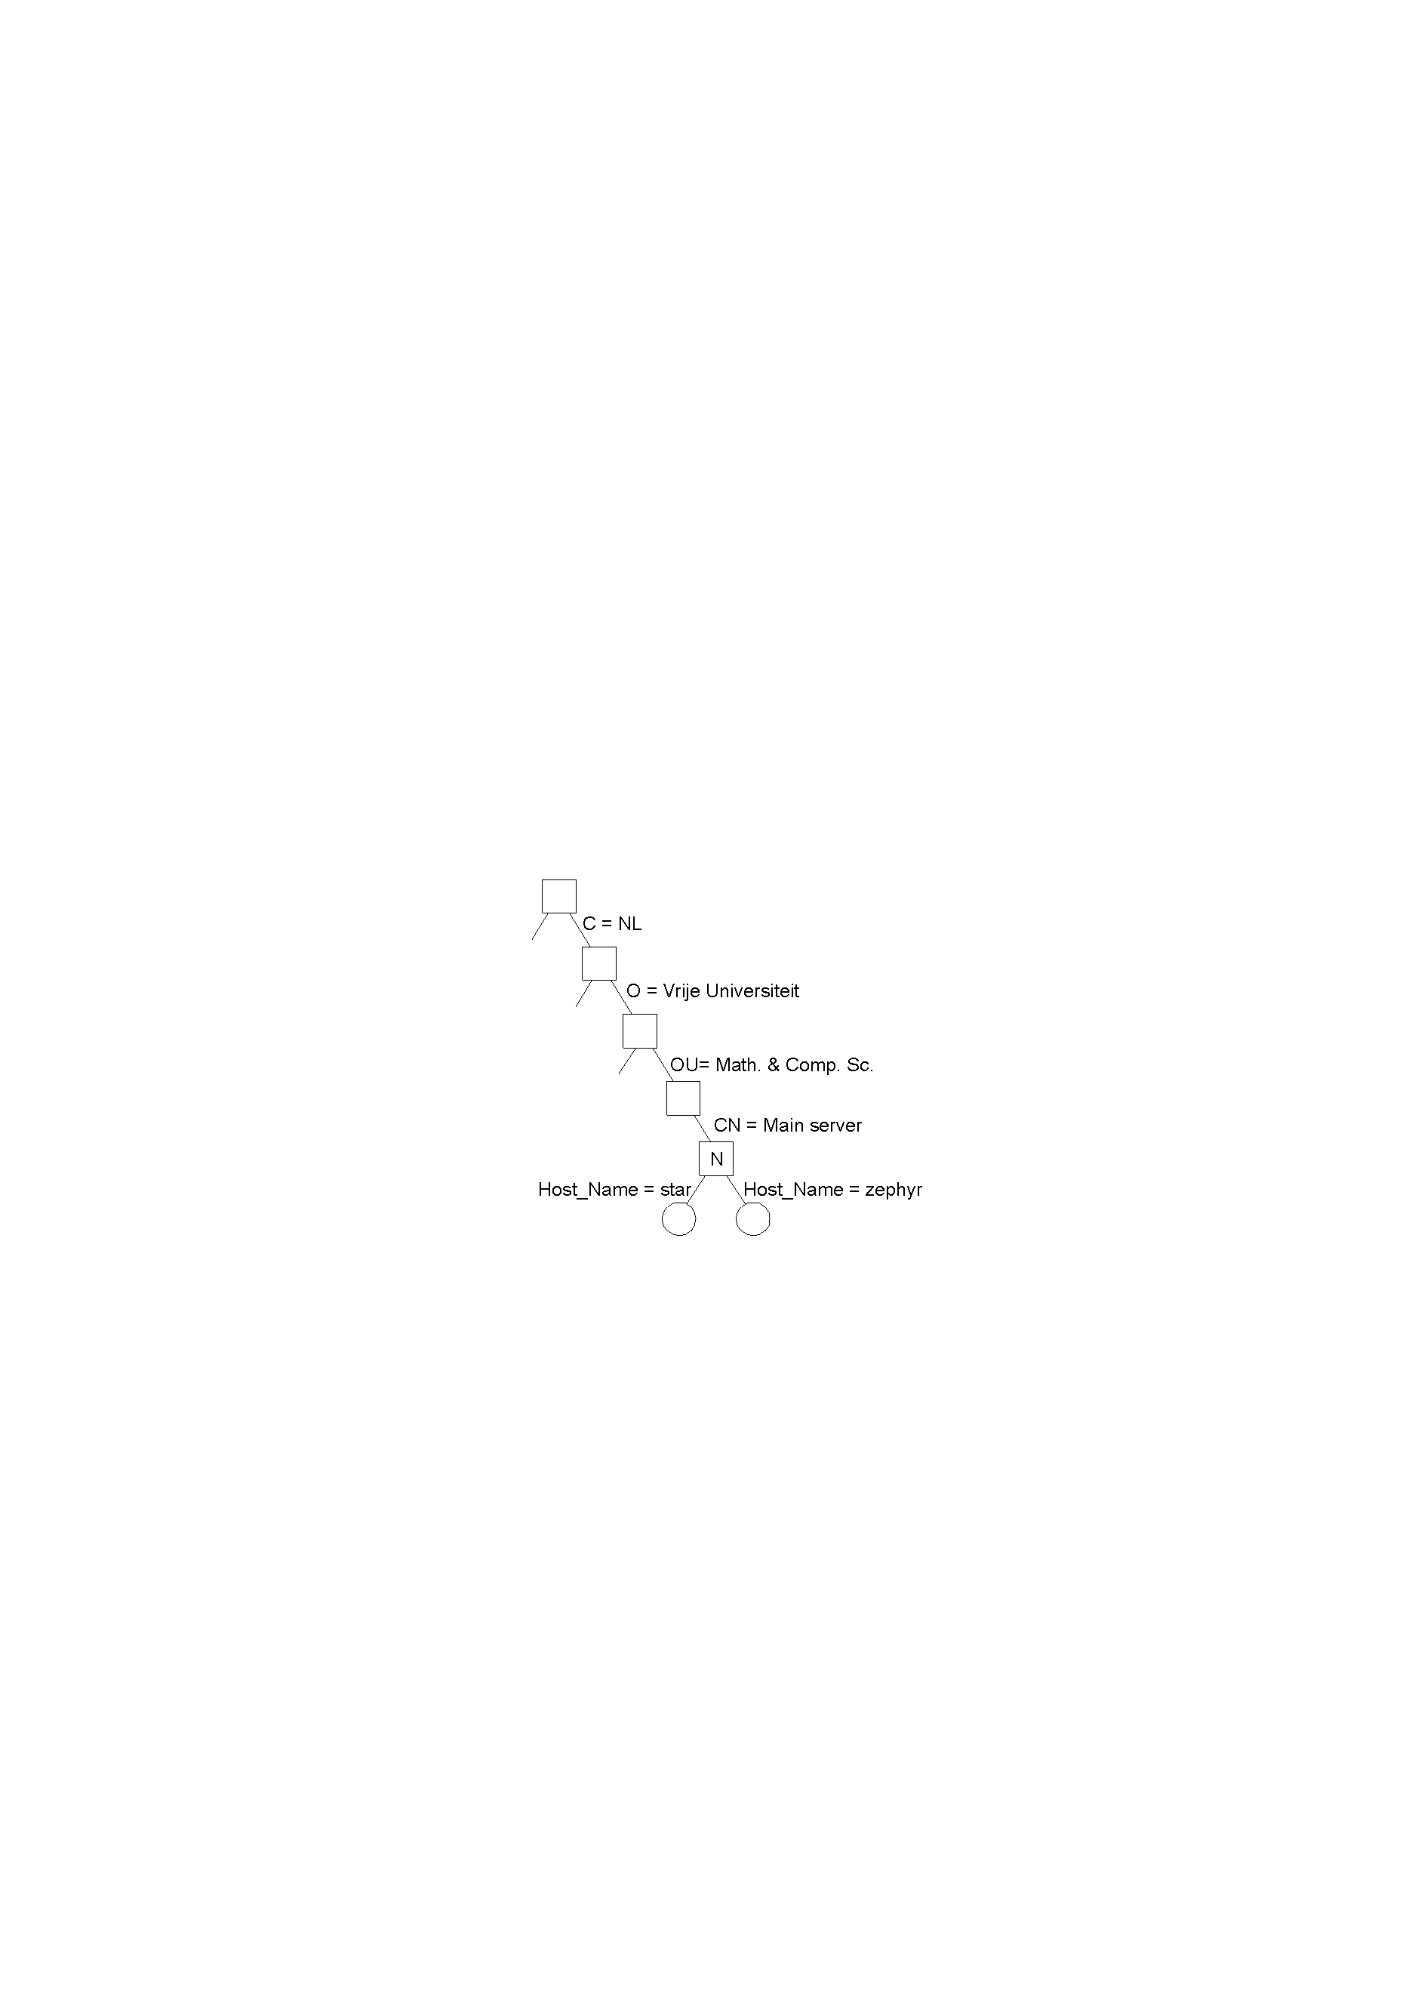
The X.500 DIT
Part of the X.500 Directory Information Tree (DIT)

Slide 54
The X.500 Name Space
Attribute | Value |  | Attribute | Value
Country | NL |  | Country | NL
Locality | Amsterdam |  | Locality | Amsterdam
Organization | Vrije Universiteit |  | Organization | Vrije Universiteit
OrganizationalUnit | Math. & Comp. Sc. |  | OrganizationalUnit | Math. & Comp. Sc.
CommonName | Main server |  | CommonName | Main server
Host_Name | star |  | Host_Name | zephyr
Host_Address | 192.31.231.42 |  | Host_Address | 192.31.231.66
Two directory entries having Host_Name as RDN.

Slide 55
X.500 Commentary
Searching the DIT is an expensive task.
Implementing X.500 is not trivial (as is the case with so many ISO standards).
On the Internet, a similar service is provided by the simpler Lightweight Directory Access Protocol (LDAP), which is regarded as a useful and implementable subset of the X.500 standards.

Slide 56
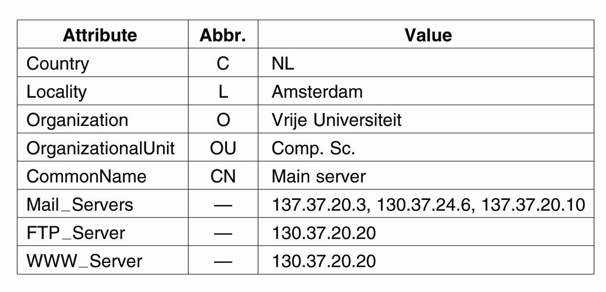
Unstructured Naming -
Example: LDAP (1)
A simple example of an LDAP
directory entry using LDAP naming conventions

Slide 57
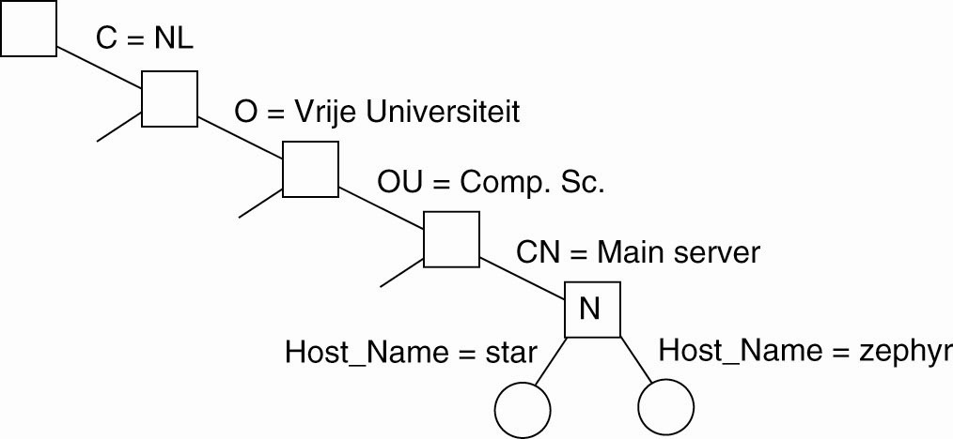
Example: LDAP (2)
(a) Part of a directory information tree

Slide 58
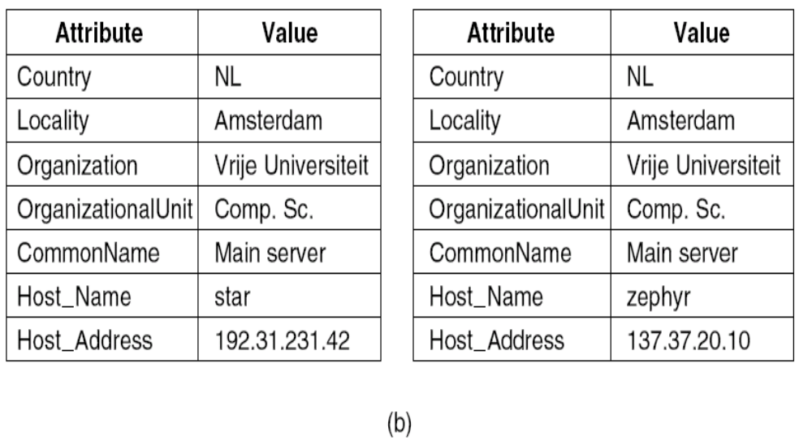
Example: LDAP (3)
(b) Two directory entries having
Host_Name as RDN

